Slide 1

Energy-Aware Adaptive Routing for Large-Scale Ad Hoc Networks:
Protocol and Performance Analysis
Authors: Qing Zhao, Lang Tong, David Counsil
Published: IEEE Transactions on Mobile Computing, September 2007
Presented by: Jay Elston

Slide 2

Contents
Message Routing in Mobile Ad Hoc Networks
  Brief background
  Motivation for energy efficiency
“Energy-Aware GEolocation-aided Routing” (EAGER)
  Novelty and contributions of the paper
  Key ideas and details of the paper
Analysis and Results
  Key results of the paper
Conclusion
  How does the paper related to the class
  How does the paper related to your project
  Conclusion

Slide 3
Mobile Device Constraints
Resource Poor
Less Secure & Reliable
Variable connectivity
  Disconnections
  Bandwidth

Slide 4
Routing in Mobile Ad Hoc Networks (MANET)
  Think about:
  methods that mobile devices that are not in range of each other might use to exchange messages.
  Which of these methods is most energy efficient?
  Under which conditions?
These are the questions…

Slide 5
A Taxonomy of Routing Schemes
Topology Based
  Proactive
    Routing information is kept at every node.
    Requires that node connectivity be update whenever the topology changes
    Suitable for high CMR
  Reactive
    Message is “flooded” (i.e. forwarded to every node possible) throughout the network.
    Suitable for low CMR
  Hybrid
Position Based
  Nodes maintain position information about other nodes.
  Not suitable for mobile networks.

Slide 6


MANET Routing
Oops, B is not in A’s range.
What should A do?

Slide 7
MANET Routing
Using Flooding

Slide 8
MANET Routing
Cluster based approach
First, the nodes organize themselves into connected clusters
Some nodes become “cluster heads”. These nodes maintain routing tables.

Slide 9
MANET Routing
Once the routing tables are established, messages can be routed efficiently.

Slide 10
Reactive vs. Proactive Routing
Energy
Reactive networking
Proactive networking
λ0
Traffic Load
Observation – Can a hybrid scheme that can adapt and use:
Reactive method when CMR < λ0, and
Proactive method when CMR > λ0
Offer any energy efficiency?

Slide 11
Problem Statement
For a large scale MANET, develop an adaptive routing strategy and analyze its energy consumption as a function of the message arrival rate and topological variation rate.

Slide 12
Approach
Use an adaptive routing strategy that optimally blends proactive and reactive approaches based on traffic load and rate of topological change
Develop a protocol to do this
  “Energy-Aware Geolocation-aided Routing” (EAGER)

Slide 13
MANET Hybrid Routing Protocols
Zone Routing Protocol (ZRP)
Energy-Aware GEolocation-aided Routing (EAGER)
Similarities | Differences
Hybrid (locally proactive, globally reactive) Partitioned into sections | Zone Overlap: ZRP – zones are heavily overlapped EAGER – zones are disjoint Optimal cell size and transmission range ZRP – determined by simulation EAGER – determined analytically Efficiency ZRP – Routing Overhead EAGER – Energy Efficient

Slide 14
How EAGER works
Partition the network into cells
  Cell size is optimized for “normal” traffic conditions
  Intra-cell routing is proactive
  Inter-cell routing is reactive
Adjust the cell size according to traffic conditions
  Join adjacent cells for form proactive hot spots
Key
Contribution

Slide 15
How EAGER works
Low CMR
Reactive Routing
High CMR
Proactive Routing
Low CMR
Reactive Routing
High CMR
Proactive Routing

Slide 16
EAGER
Node classification
Nodes near cell boundaries are classified as “periphery” nodes
Nodes in the interior of a cell are classified as “inner” nodes.

Slide 17
EAGER – Intercell Reactive Routing
When the target node is outside the source node’s cell, flooding is still used.
However, fewer messages are needed to flood the network.
Traffic flows passes through each cell only once.
Message is only flooded to one or two adjoining cells.

Slide 18


EAGER Inter-Cell Reactive Routing
Message is only flooded to one or two adjoining cells.
Message is optimally routed within the cell.

Slide 19
EAGER
Parameter Optimization
rI
In-Cell transmission range
Cr
Cell Radius
Ap
Size of “peripheral” area
Optimize with respect to “energy efficiency”.

Slide 20
EAGER
Parameter Optimization
A_{p} should be as small as possible, but:
  The Cross-cell transmission range needs to be large enough to contain the entire Ap.
  Needs to be large enough to ensure it contains at least one node.
r_{I} should be as small as possible as well.
  Energy required to transmit a given distance increases exponentially as the distance increases
  The number of nodes that will “wake up” to process the message increases exponentially as the distance increases
  Note – there is a minimum transmission range based on the minimum amount of energy that a radio is capable of transmitting
c_{r} can vary between 0 and R
  0 for low CMR, routing will always be reactive
  R for high CMR, routing will always be proactive

Slide 21
EAGER Environmental
Parameters
Some terms
  po Probability of outage specified by Quality of Service
  Po Probability that a request cannot reach every cell
  r_{C} Cross-cell transmission range
  r_{min} Minimum radio transmission range for network connectivity
  r₀ Minimum possible radio transmission from a transmitter
  ε_{t} Total energy consumed during time t
  N Total number of nodes in the network
  R The radius of the network
  ρ The node density

Slide 22
EAGER Analysis
Environmental and Derived Parameters
  M(c_{r}) – Number of cells in the network for a given c_{r}
  L(c_{r}) – Number of “levels” from the center of the network to the edge
  B_{N} – Number of bits for a node address = [logN]
  B_{C} – Number of bits for a cell ID = [logM]
  B_{P} – Number of bits for a paging sequence = [log(N+3)]
  B_{M} – Average number of bits per message
  λ_{n} – the rate that polling is done for intra-cell routing
  E_{tx}(r) – the energy required to transmit one bit a distance of r
  E_{rx} – the energy required to receive and process one bit

Slide 23
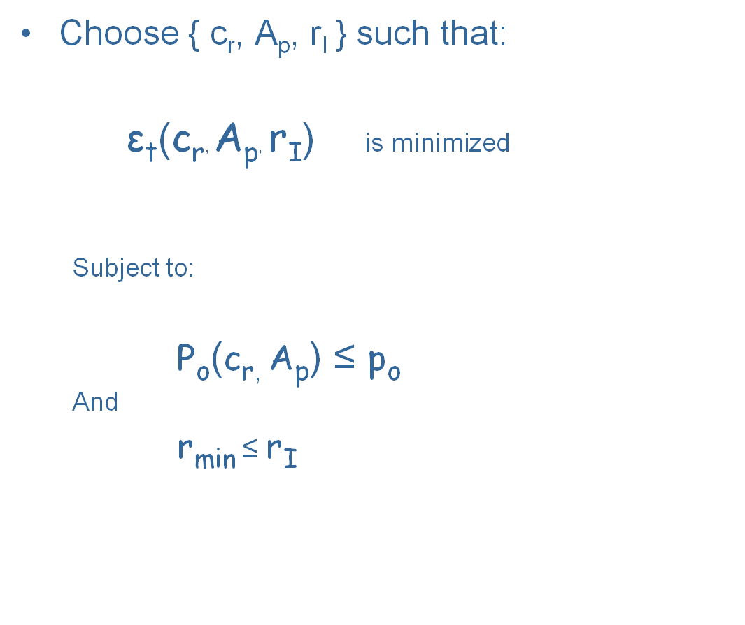
EAGER
Parameter Optimization

Slide 24

EAGER Analysis
Transmission range
  Minimum transmission range
        r ≥ r₀
  Network connectivity
      Let:
        r_{c}(N)
      be the minimum transmission range that ensures connectivity in a network with N nodes.
      Then:
        r ≥ r_{c}(N)
      As N → ∞, r_{c}(N) becomes

Slide 25
EAGER Analysis
Number of Hops
  Let h(x,r) be the number of hops
    x is the distance between source & target
    r is the transmission radius
  Converges to x/r for large networks

Slide 26
EAGER Analysis
Energy Consumption comes from
  In-cell proactive routing
  Cross cell reactive routing
  Message transmission

Slide 27
EAGER Analysis
ε_{HN,I} – the in-cell energy required for proactive
    routing during one time unit
    Function of: N, M, R, λ_{n}, B_{N}, B_{P}, B_{C}, E_{tx}(r), E_{rx}
ε_{HN,C} – the cross-cell energy required for reactive
    routing per time unit per message
    Function of: N, M, R, L, ρ, c_{r}, r_{I}, r_{C}, λ_{n}, B_{N}, B_{P}, B_{C}, E_{tx}(r_{I}), E_{tx}(r_{C}), E_{rx}
ε_{HN,M} – the energy required for transmitting
    messages per time unit per message
    Function of: N, M, R, L, λ_{n}, c_{r}, B_{M}, B_{N}, B_{P}, E_{tx}(r_{I}), E_{tx}(r_{C}), E_{rx}
ε_{HN} – the total energy consumed during
    one time unit

Slide 28
EAGER Analysis
Variations analyzed:
  Pure proactive
  Pure reactive
  Hybrid, uniform call rate
  Hybrid, localized call rate (#hops=2)
  Hybrid, localized call rate (#hops=6)
Parameters
  R = 1000
  N = 30000
  B_{M} = 500

Slide 29
EAGER Results
Analysis
  Changing message rate (λ_{m} = [10⁻⁵, 10^{-0.5}])
  EAGER vs. Proactive & Reactive
  Cell Size as traffic load increases
Changing mobility rate (λ_{n} = [10⁻⁶, 1])
  Optimal cell size
“Mis-tuned” λ_{m}
  Tuned for λ_{m}, actual varies ±80%

Slide 30
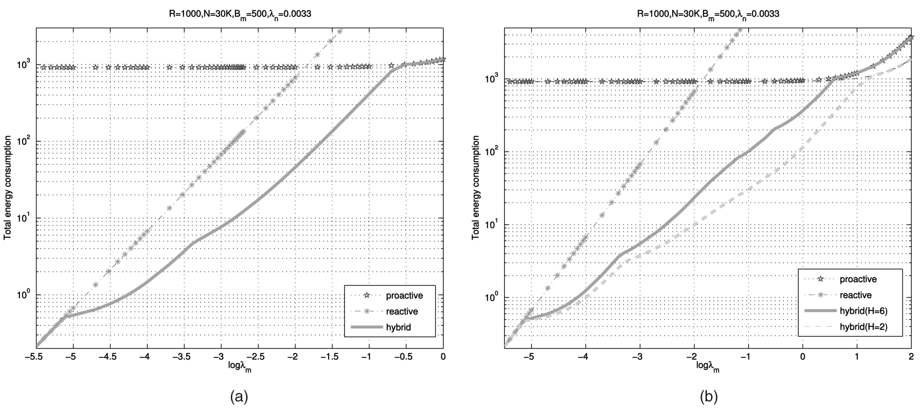
EAGER Results
Energy consumption of proactive, reactive, and hybrid networking. (a) Uniform traffic. (b) Localized traffic.
Note the λ0 point
EAGER out performs both.

Slide 31
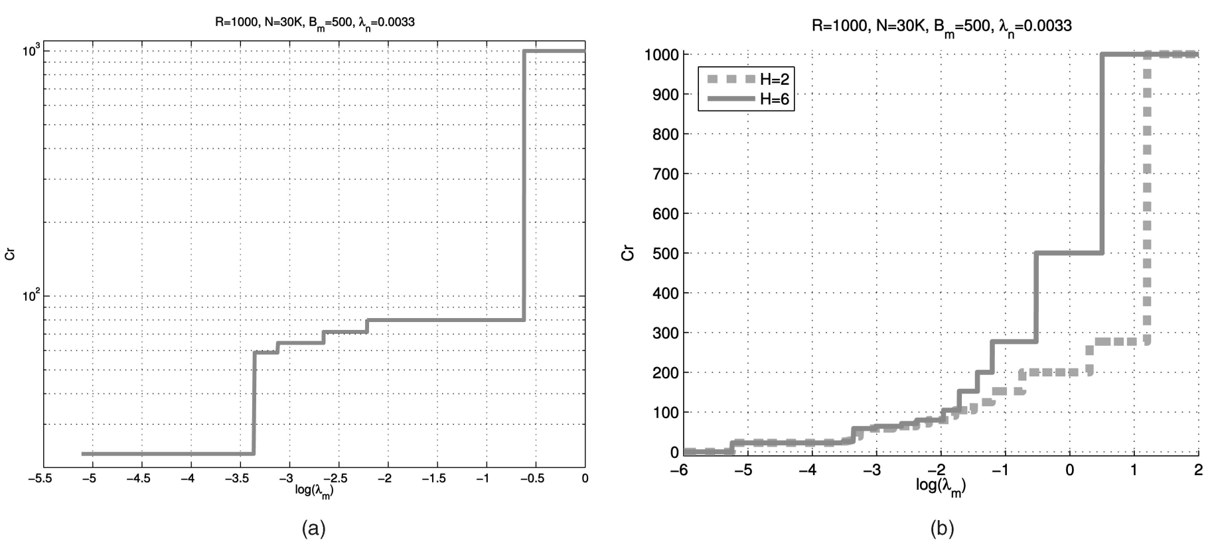
EAGER Results
Impact of traffic load on the optimal cell size (s) Uniform traffic. (b) Localized traffic.
This “experiment” demonstrates when cell combining takes place.

Slide 32
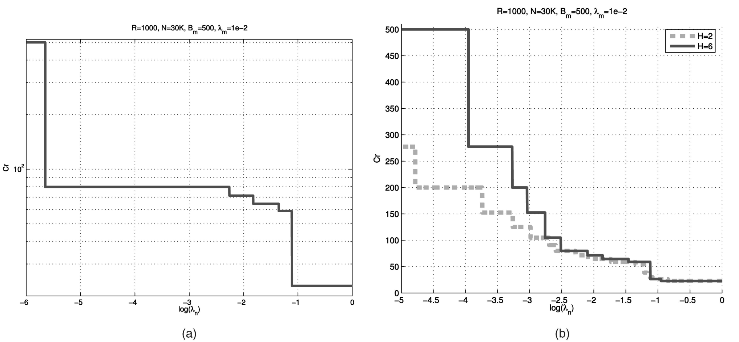
EAGER Analysis
Impact of mobility rate on the optimal cell size. (a) Uniform traffic. (b) Localized traffic.
This “experiment” demonstrates cell size decreasing as mobility
increases (mobility lowers CMR).

Slide 33
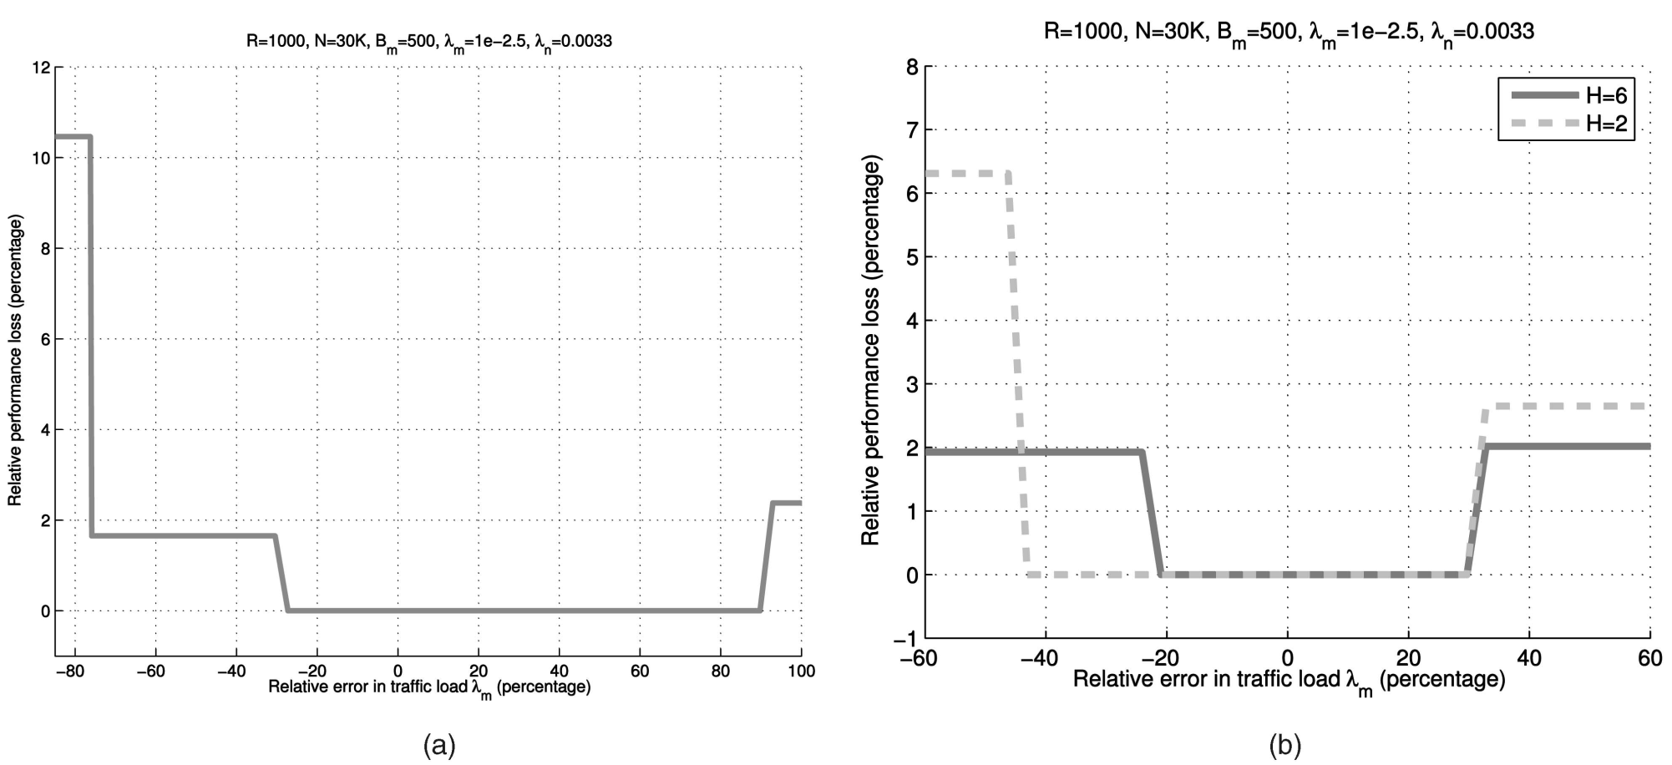
EAGER Analysis
Impact of estimation errors in traffic load on the performance of EAGER.
Uniform traffic.
Localized traffic.
This “experiment” demonstrates that the protocol seems to be robust – even when “tuned” for different parameters.

Slide 34
EAGER Results
Analysis indicates
  EAGER offers up to 2 orders of magnitude energy savings with respect to purely proactive and reactive schemes
  EAGER perform similarly with uniform or localized messaging patterns
  EAGER is robust with respect to estimation errors in the message rate.
    Even with message rates 80% different from what was expected, energy efficiency is affected by 11%
Hybrid routing is more energy efficient than purely reactive or proactive routing
Adaptive techniques are key to implementing hybrid approaches

Slide 35
EAGER Class Tie-Ins
Class Theme | Research Results
Constraints on mobile devices | Efficient use of energy
Adaptability | Adaptable routing based on CMR

Slide 36
EAGER Project Tie-Ins
My project has three objectives
  1) Duplicate the results of this research
  Extend it by
    2) Analyzing and simulating the change in efficiency of using location registries.
    3) This paper proposes a hexagonal cell geometry. How would different cell geometries affect the energy efficiency of this scheme?

Slide 37
Conclusions
This research is contains rigorous analysis
The analysis results are convincing, but need to be backed up with simulation and/or experiments.
Real-world concerns for the proposed protocol
  How necessary is it to adapt to low CMR scenarios?
  This protocol is not robust with respect to “holes” in the network.
    If a cell is empty, flooding can fail
No direct comparison was made with ZRP
Overhead for “cell combining” was not accounted for in the analysis.
Only analysis for one network size and density was performed (N=30000, R=1000)
  Some analysis varying N & R would have been helpful in verifying the relationship between r_{min}, N and R.

Slide 38
References
Q. Zhao, L. Tong, D. Counsil; “Energy-Aware Adaptive Routing for Large-Scale Ad Hoc Networks:
Protocol and Performance Analysis”; IEEE Transactions on Mobile Computing, September 2007
S. Basagni; “Distributed Clustering for Ad Hoc Networks”; International Symposium on Parallel Architectures, Algorithms and Networks (ISPAN), pages 310–315. IEEE Computer Society, 1999.
F. Adelstein, S. Gupta, G. Richard III, L. Schweibert; Fundamentals of Mobile and Pervasive Computing. McGraw-Hill, New York, 2005
M. Pearlman, Z. Haas; “Determining the Optimal Configuration for the Zone Routing Protocol”, IEEE Journal Selected Areas in Communications, vol. 17, pp. 1395-1431, Aug 1999

